Slide 1

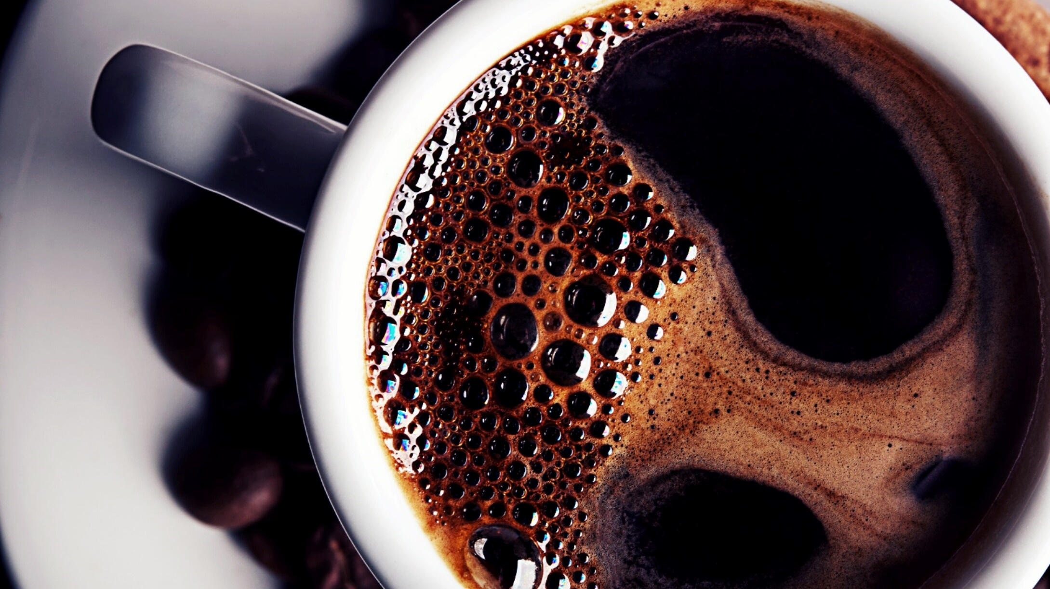
Bright Coffee Shop
Sales Analysis

Slide 2

Bright Coffee Shop Sales Analysis
Introduction:
The purpose of the Case Study is to conduct Data Analysis to gain bbusiness insights for a New CEO using Historical Transactional Data from Bright Coffee Shop.
I have extracted actionable insights from historical data and prepared a presentation to assist the CEO in decision-making.

Slide 3
Bright Coffee Shop Sales Analysis
Report on findings:
The presentation will provide information on the following:
Which products generate the most revenue
What time of day the store performs best
Sales trends across products and time intervals
Recommendations for improving sales performance

Slide 4
Bright Coffee Shop Sales Analysis
Which products generate the most revenue:
The products that generate the most revenue are :
Coffee
Tea
Bakery
Drinking Chocolate

Slide 5
Bright Coffee Shop Sales Analysis
Which products generate the most revenue:

Slide 6
Bright Coffee Shop Sales Analysis
What time of day the store performs best
The Best and Peak time for sales between 7am and 10am.
The off peak times are 6am, 7pm to 20pm.

Slide 7
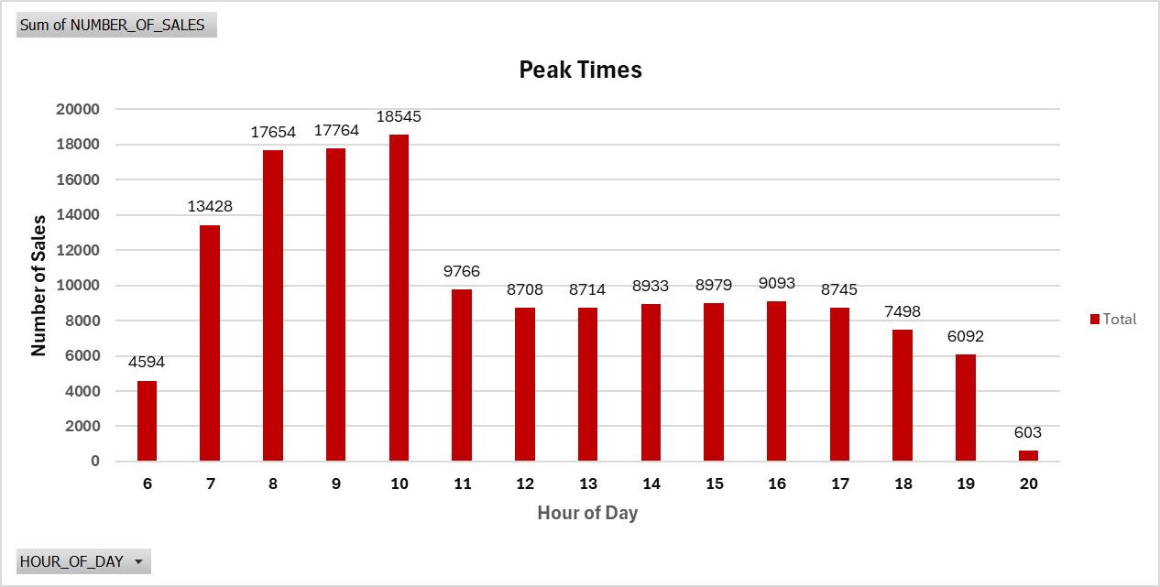
Bright Coffee Shop Sales Analysis
What time of day the store performs best:

Slide 8
Bright Coffee Shop Sales Analysis
Sales trends across products and time intervals
Saled Peak during Mid Morning and Morning Periods.
Saled a lower during evenings.

Slide 9
Bright Coffee Shop Sales Analysis
Sales trends across products and time intervals

Slide 10
Bright Coffee Shop Sales Analysis
Introduction:

Slide 11
Bright Coffee Shop Sales Analysis
Introduction:

Slide 12
Bright Coffee Shop Sales Analysis
Recommendations for improving sales performance:
🌅 Early Morning (Before 8 AM)
“Early Bird” Combos
Offer discounted breakfast bundles (e.g., coffee + pastry) to attract commuters and early risers.
Pre-Order & Pickup Incentives
Promote mobile ordering with a small discount or loyalty points for pickups before 8 AM.

Slide 13
Bright Coffee Shop Sales Analysis
Recommendations for improving sales performance:
Free Upsize or Add-On
• Provide a free size upgrade or extra shot of espresso for early customers.
“First 20 Customers” Perks
• Create urgency with limited-time offers like “Free muffin for the first 20 customers.”

Slide 14
Bright Coffee Shop Sales Analysis
Recommendations for improving sales performance:
Evenings (After 5 PM)
Relaxed Ambience & Events
Dim lighting, soft music, or live acoustic sets can turn the shop into a cozy evening hangout.
Happy Hour Specials
Run “coffee happy hours” with 2-for-1 drinks or dessert pairings between 5–7 PM.
Board Games or Book Club Nights
Host casual community events to encourage lingering and group visits.

Slide 15
Bright Coffee Shop Sales Analysis
Recommendations for improving sales performance:
- Evening-Only Menu
- Introduce exclusive items like herbal teas, light snacks, or dessert platters only available in the evening.
- Remote Work Perks
- Offer Wi-Fi + drink bundles or “Work Late” packages for freelancers and students.

Slide 16
Bright Coffee Shop Sales Analysis
Introduction:

Slide 17
Bright Coffee Shop Sales Analysis
Thank You

